Slide 1
Notes:
I'm Andrew, and I'm a psychology student.
One of my psychology textbooks inludes a small, lighthearted section on improving your odds when stumped by a question in a multi-choice exam.

Slide 2
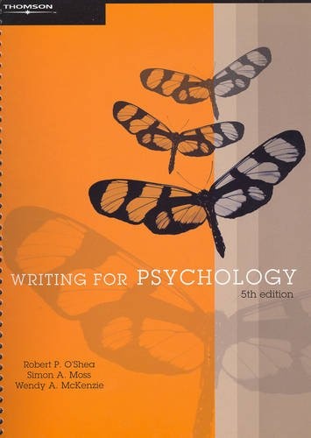
Notes:
The authors offer suggestions such as chosing the longest answer and avoiding answers containing absolute terms. But they don't cite any data to back up their subbestions, and I couldn't find any myselt.
That got me thinking if it would be possible to improve your odds in multiple choice exams without knowing anything about the material.

Slide 3
Notes:
So essentially, my project is about looking for patterns in data to let me pass exams without studying, or perhaps for allowing academic staff to make their tests a but fairer.
I'm going to start off talking about my dataset and how I processed it. All of the assignment's we've done so far in this class have been with nice structured data imported from R packages. Real data has errors and missing values and other nastly things like that, which do affect the quality of your results.
Finally, I'll talk about the statistics I used, and the results of my analysis.
First up, I needed a dataset. I needed exam questions, as well as solutions. I had some requirements for a good dataset.

Slide 4
Notes:
It needed to be in a digital format. I didn't want to do any data entry, and Maro didn't provide us with a buget for research assistants.
I wanted a dataset that could was representative of any multichoice exam. I was interested in exploiting general psychological biases in test contruction, rather than finding the answers to Mr Smith's 3rd form chamistry class.
It would also be nice to have it in a CSV for SQL format than can be easily imported into statisitcal software packages.

Slide 5

Notes:
Eventually I found the Australian Sciance Olympiads. Some of the students here might remember doing these at school. They're sat by high school children in australia and NZ.

Slide 6
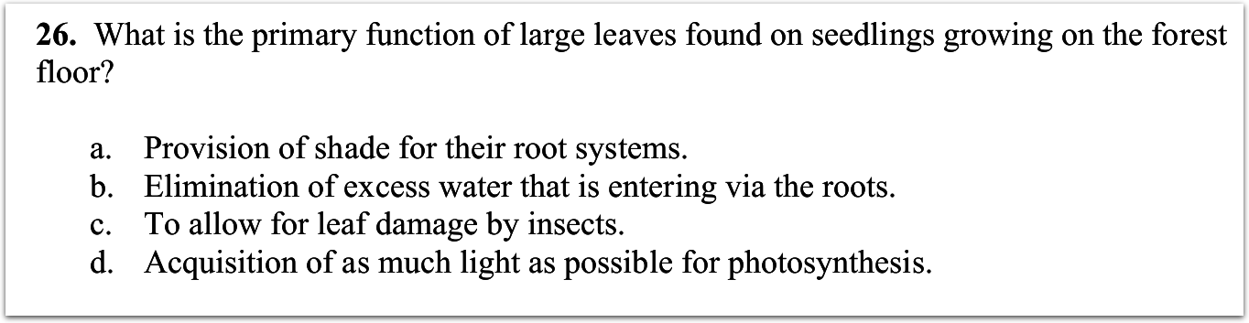
Notes:
They come in a few different jubjects, but they have questinos like this.

Slide 7
Notes:
So the exams are all online, in pdf format along with a solution schedule. There is a total of 402 questions with 1800 possible answers.
This project will treat the answers as observations, and attempt to categorise them as correct or incorrect, with the contraint that only one can be correct per question.

Slide 8
Notes:
The exams are published by an organisation, so it's likely that any test-writing guidelines they use will be similar to what is used for the GRE or other multi choice test organisations.
I also wanted to ensure the tests were written by a wide range of people, to smooth out any individual biases.
It's unlikely that one person would produce tests for 3 subjects over 6 years, but it turns out you can get an even better idea.The PDF file format contains the name of the user creating it. So this is the 2007 biology paper, which was written by mary oliver. There were 8 authors over the 19 papers, with a few double ups and a few with no author listed.

Slide 9
Notes:
So it was looking pretty promising, until I tried to deal with the PDF data.
It turns out that PDFs are all about presentation. There are literally hundreds of ways to specify a layout in PDF, and have it look exaclty the same.

Slide 10
Notes:
So simple text extraction wasn't enough, as it could only handle about half the questions.
So I took the questions that coudln't be extracted, and ran them through optical character recognition.

Slide 11
Notes:
It works by turing the PDF into an image, and then extracting the text from the image.
It worked pretty well, and picked up most of the questinos that had previously failed.
However, a few questions couldn't be parsed by either method. There were basically 2 reasons for this.

Slide 12
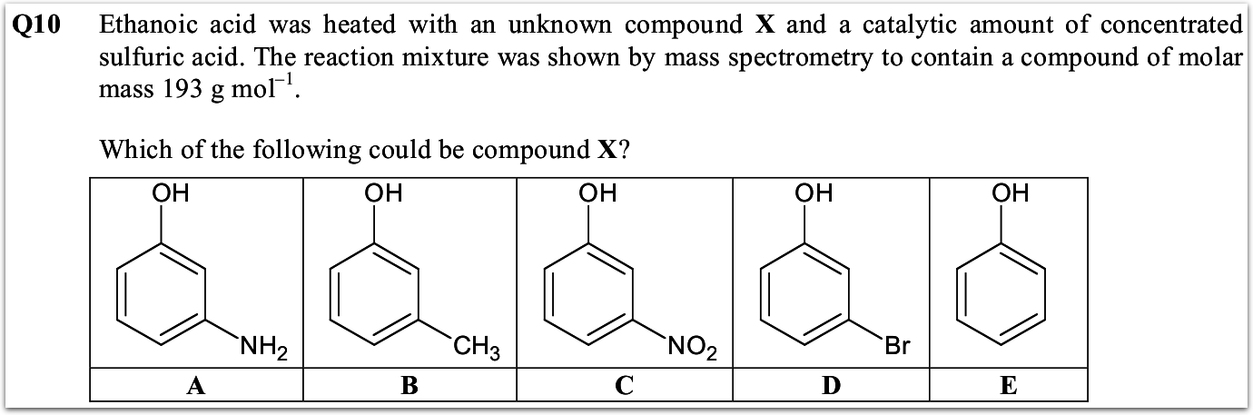
Notes:
One is unavoidable. There's no easy way to represent pictures and diagrams in a way to analysae statisitcally, and even harder to automatically extract this.

Slide 13
Notes:
There are also some errors that would be overcome by better tuning of the OCR program, or by manual data entry.

Slide 14
Notes:
So, of the original data set, 80% could be successfully converted to text using either extraction or OCR.
Of the remaining 20% of unsuccessful conversions, half were due to unavoidable errors, and half due to avoidable ones.
I'm not too worried by this. Because these errors are dealing with questions, rather than the answer observations, it doesn't affect the proportion of correct answers.

Slide 15
Notes:
A slightly greater concern is that this skews the distrubtion of the subjects. They were already skewed to begin with, but the final dataset is heavily biased towards biology. Again, not an issue for the model's internal validity, bu may reduce representativeness.

Slide 16
Notes:
The last step involves generating the features or parameters of each observation. I looked at objective counts like the number of words in the answer,
Because some of the answers had numerical values, I also looked at their numerical value, and related things.
and true/false checks like whether the question had inverse logic.
The booleans were scaled between 0 and 1 or -1 and 1. This allows for the parameters to be flipped if the question logic changes, or for false values to be ignored the model, thanks to interaction effect.

Slide 17
Notes:
I ended up with a pretty healthy dataset of 1200 answers and 32 features. Now I could do some analysis

Slide 18
Notes:
The first thing I tried was a logistic regression. The result was no better than random, and no single parameter had a significan correlation. A few were kind of close, but there is no way you could say that doing any 2 or 3 simple things would have a robust effect.
I still wanted to try some interaction tems and nonlinearites, but with 35 parameters, it would be a tall order to do them myself.
Instead, I used a neural network.

Slide 19
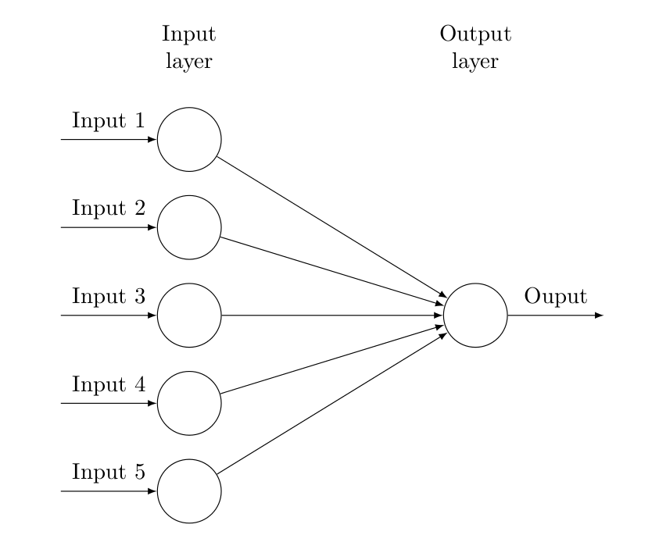
Notes:
A neural network is a computationl model, that can be used to make predictions.
This shows a simple neural model. Each parameter is given an input node on the left. A linear function is applied to each node, and the result or output is shown on the right.
This simple network is just doing linear regression – a weighted sum of terms.

Slide 20
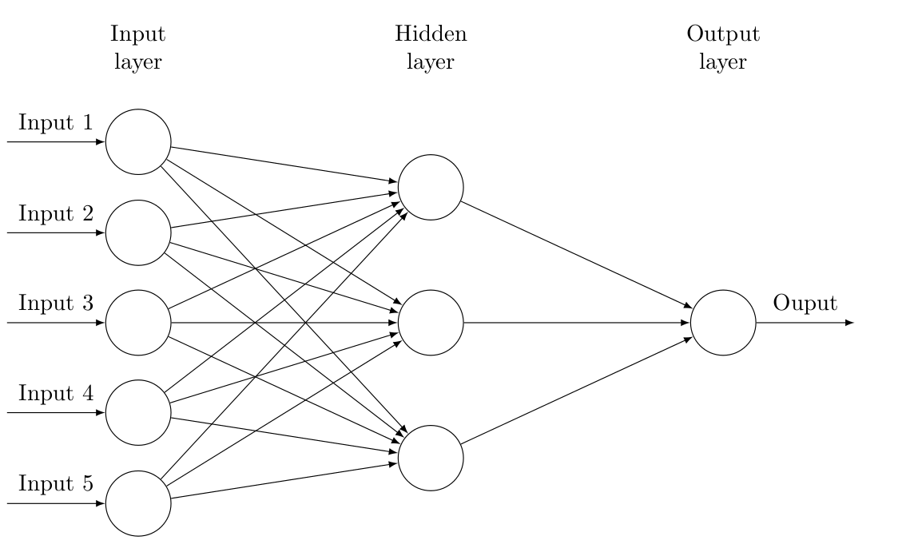
Notes:
Things start to heat up when you add more layers between the input and output. It's like doing regressions of regressions. You can model nonlinearities like interaction effects, and the neural network picks the parameters.
The main problem is that it is hard to interpret. The interactions are likely more complicated than the underlying phenomena.

Slide 21
Notes:
Things start to heat up when you add more layers between the input and output. It's like doing regressions of regressions. You can model nonlinearities like interaction effects, and the neural network picks the parameters.
The main problem is that it is hard to interpret. The interactions are likely more complicated than the underlying phenomena.

Slide 22
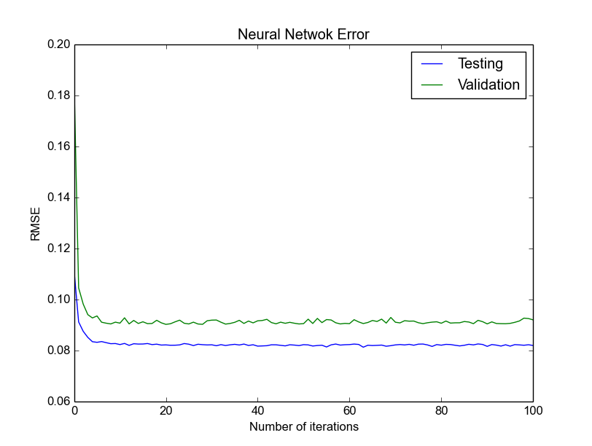
Notes:
Things start to heat up when you add more layers between the input and output. It's like doing regressions of regressions. You can model nonlinearities like interaction effects, and the neural network picks the parameters.
The main problem is that it is hard to interpret. The interactions are likely more complicated than the underlying phenomena.

Slide 23
Notes:
Things start to heat up when you add more layers between the input and output. It's like doing regressions of regressions. You can model nonlinearities like interaction effects, and the neural network picks the parameters.
The main problem is that it is hard to interpret. The interactions are likely more complicated than the underlying phenomena.

Slide 24
Notes:
Things start to heat up when you add more layers between the input and output. It's like doing regressions of regressions. You can model nonlinearities like interaction effects, and the neural network picks the parameters.
The main problem is that it is hard to interpret. The interactions are likely more complicated than the underlying phenomena.

Slide 25
Notes:
Things start to heat up when you add more layers between the input and output. It's like doing regressions of regressions. You can model nonlinearities like interaction effects, and the neural network picks the parameters.
The main problem is that it is hard to interpret. The interactions are likely more complicated than the underlying phenomena.

Slide 26
Notes:
Things start to heat up when you add more layers between the input and output. It's like doing regressions of regressions. You can model nonlinearities like interaction effects, and the neural network picks the parameters.
The main problem is that it is hard to interpret. The interactions are likely more complicated than the underlying phenomena.

Slide 27
Notes:
Things start to heat up when you add more layers between the input and output. It's like doing regressions of regressions. You can model nonlinearities like interaction effects, and the neural network picks the parameters.
The main problem is that it is hard to interpret. The interactions are likely more complicated than the underlying phenomena.

Slide 28


